Slide 1
Components of a Data Center

Slide 2
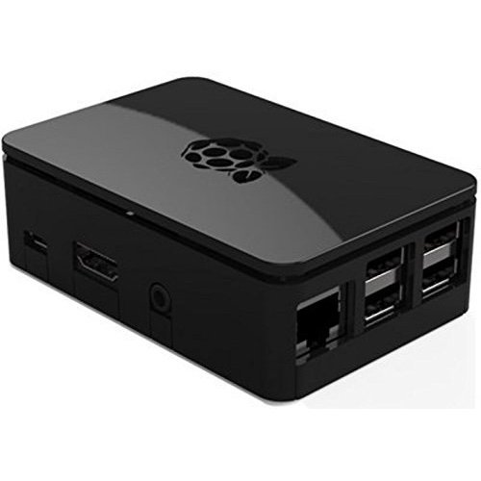
Nano Data Center
Local Graph
Edge Device is a Nano Data Center
Local Apps
Local
Web Pages
Local Web
Sockets

Slide 3
User View of A Nano Data Center
User
App1
Access
Library
Web Server
Docker
Container
Nano
Data
Center
Docker
Container
User
App2
Access
Library
IOT
Interface
Docker
Container
User
Appn
Access
Library

Slide 4
Why is a Data Center Approach Important
Need to know that target if functioning correctly
Examining operating parameters
Examining time histories of operating parameters ( strip charts )
Examining output logs
Need to detect system and program crashes ( Nothing is Perfect )
Need to capture crash logs
Need to capture system and program logs
Need to display data to a user in a meaningful way.
Data Center Operations have been doing this for many years
Only path that users have visibility into the system.

Slide 5
List of References
The Art of Monitoring by James Turnball -- main reference
Practical Monitoring by Mike Julian
Monitoring with Graphite by Jason Dixon
Effective Monitoring and Alerting by Slavek Ligus

Slide 6
Tools Covered
Riemann – Message Broker
Graphite – data store
Influxdb – time series data base
Elastic Search – analyzing logs
Web Frame Work to Display Results

Slide 7
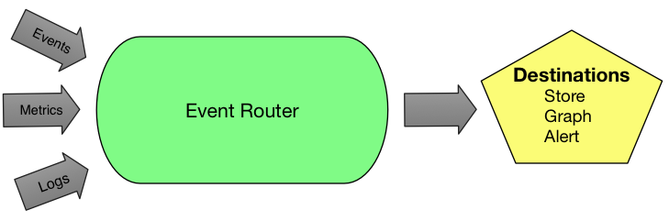
Event Router Reimann

Slide 8
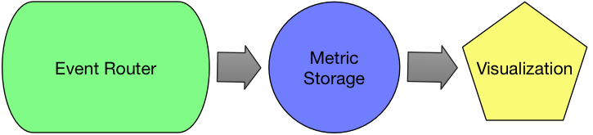
Data Store and Visualization Graphite Data Base and Grafana Web Server

Slide 9
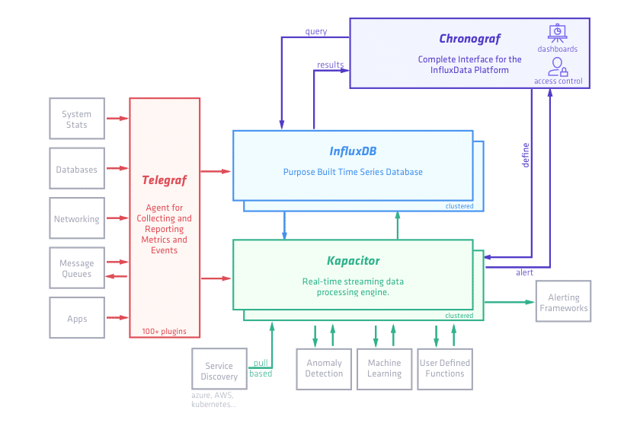
Time Series Database

Slide 10
Elastic Search
Kabana Web Server
Various
Event
streams
Logstash/Beats Process
Various
Log files
Elastic Search Data Base
Document Data Base
With Inverted Indexes for Text
Searching
Logstash process consists of plugins that process logfiles with grep like processing.
Plugs can feed other plugins. The end result is a json object that is stored in the Elastic Search
Database.

Slide 11
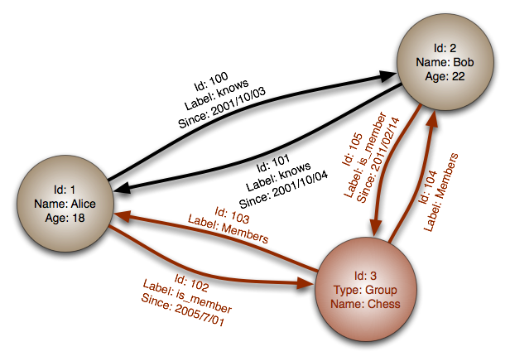
Graphical Data Bases
Note the Node is a python dictionary
Note the Label is a python dictionary

Slide 12
Restrictions On Data Center Graphs
The graph is a directed graph
The traversal of the graph is in one direction
The graph is restricted to a tree structure
A node can only be linked by one relationship
A node can link to an indeterminate number of nodes
The graph becomes one like SNMP
The graph is static. Once created it is not changed.
To change the graph requires deleting the graph and recreating the graph

Slide 13
Example of Tree Structured Graph
Head Node
Sub Node 1
Sub Node 2
Sub Node 3
Sub Sub Node 1

Slide 14
SNMP is very hard to understand Why is the graphical database any different?
The Nodes and the Relationships are equivalent to python dictionaries
Python Api’s will be available to access the graph
A “SQL like” query language is used to query the graph
The definitive query language for graph databases is Cypher by Neo4j
This query language is what makes graphically data bases effective.

Slide 15
Example of Power of Graphical Data Base
Consider the following Problem.
Find the network addresses of slaves devices attached to controller “A”
We are given a graph containing the entire system
Controllers are linked to the graph by the relationship name “CONTROLLER”
SLAVE Devices are linked to the graph by the relationship name “SLAVE”
The solution would be to use the following query
MATCH (controller:CONTROLLER {name:’A’})-[*]-(*)-[:SLAVE]->(slave)
RETURN slave
The * means go on an indefinite search till SLAVE relation is found

Slide 16
Constructing the graphical database
The number of nodes which comprise the database can be quite large.
The most efficient way to load this data base is by a python script.
The python script based approach has two advantages.
The start of a header node and the termination of the header node can be checked while constructing the graph.
The script starts with “start_header_node(“a”)
Adding graph nodes and sub nodes
When done with this part of the subgraph the following statement issued
end_header_node(“a”)
The “a” have to match to keep the tree intact
The second advantage is that python supports classes. Classes can be made of common objects like site, controllers, slaves and other things. The classes make assembling the python graph much easier.

Slide 17
Nature of Application Web Pages
Over a period of 20 years there is a need for a local web server located at the node device. Many times attempts have been made to remove it and was quickly put back in place.
There are many applications running, but there can only be one web server. Therefore, applications must integrate into a single web frame work.
Rules for the web frame work.
Web pages must support a mobile touch layout
Need to navigate to any web page within 3 clicks

Slide 18
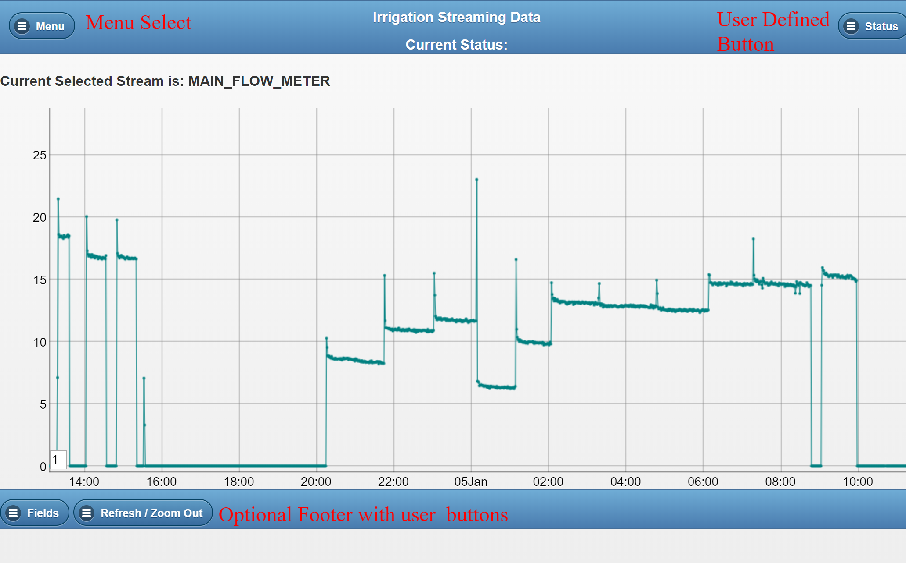
A typical web layout

Slide 19

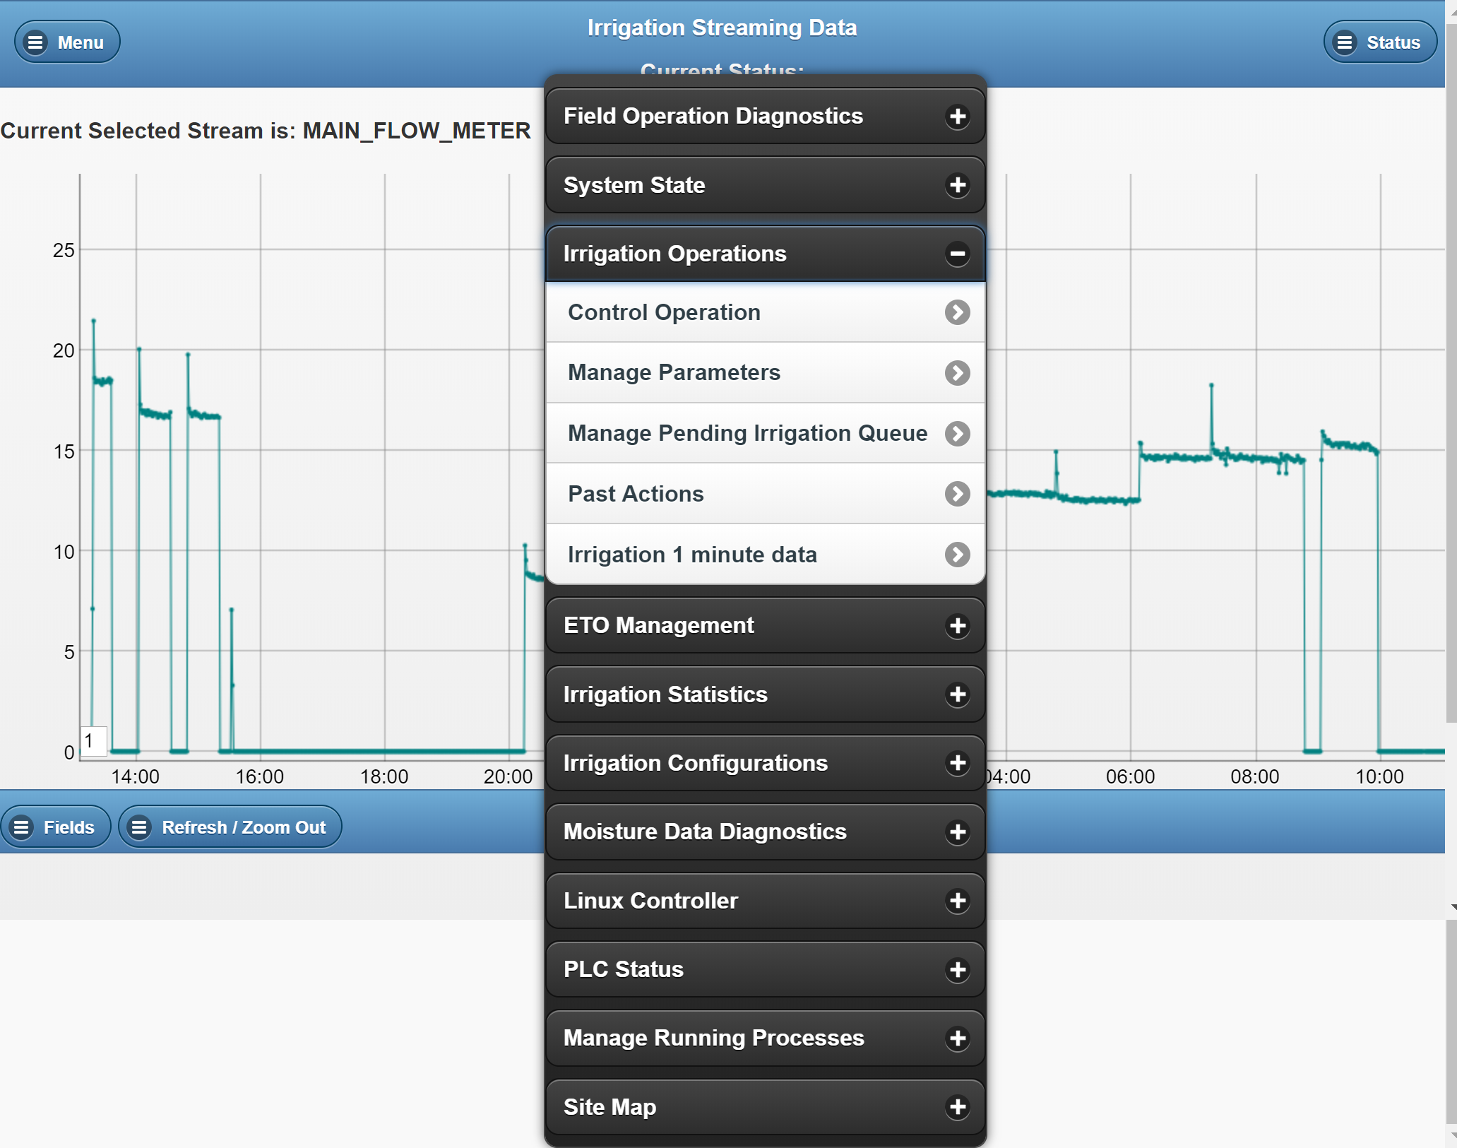
Example of Menu Selection with Pop Up Menu

Slide 20
Web Frame Works Continued
Applications live within the framework. The framework offers:
Authentication is provided by the framework
A mobile framework such as jQuery mobile, React Bootstrap
Navigation is taken care of by the framework
A common template to add application code into
JavaScript and Css files are included into the template. No files except for library files

Slide 21
Web Sockets
Many user applications require telnet or ssh type use cases.
For lack of a better term console services
A Web Socket Service is setup to allow users setup web Sockets
Setting up Web Socket Service is straight forward
Main problem with Web Sockets is Security

Slide 22
Summary of Required Functions
Event Hub
Data Store
Time Series
Elastic Search Functions
Web Frame Work
Graphical Database Supporting Cypher
Run on 32 bit system with 1 Gig of Memory
This is the essence of the Nano Data Center

